Slide 1

Case Study 94: Secure Online Voting System
Pratik Kumar Swain

Slide 2
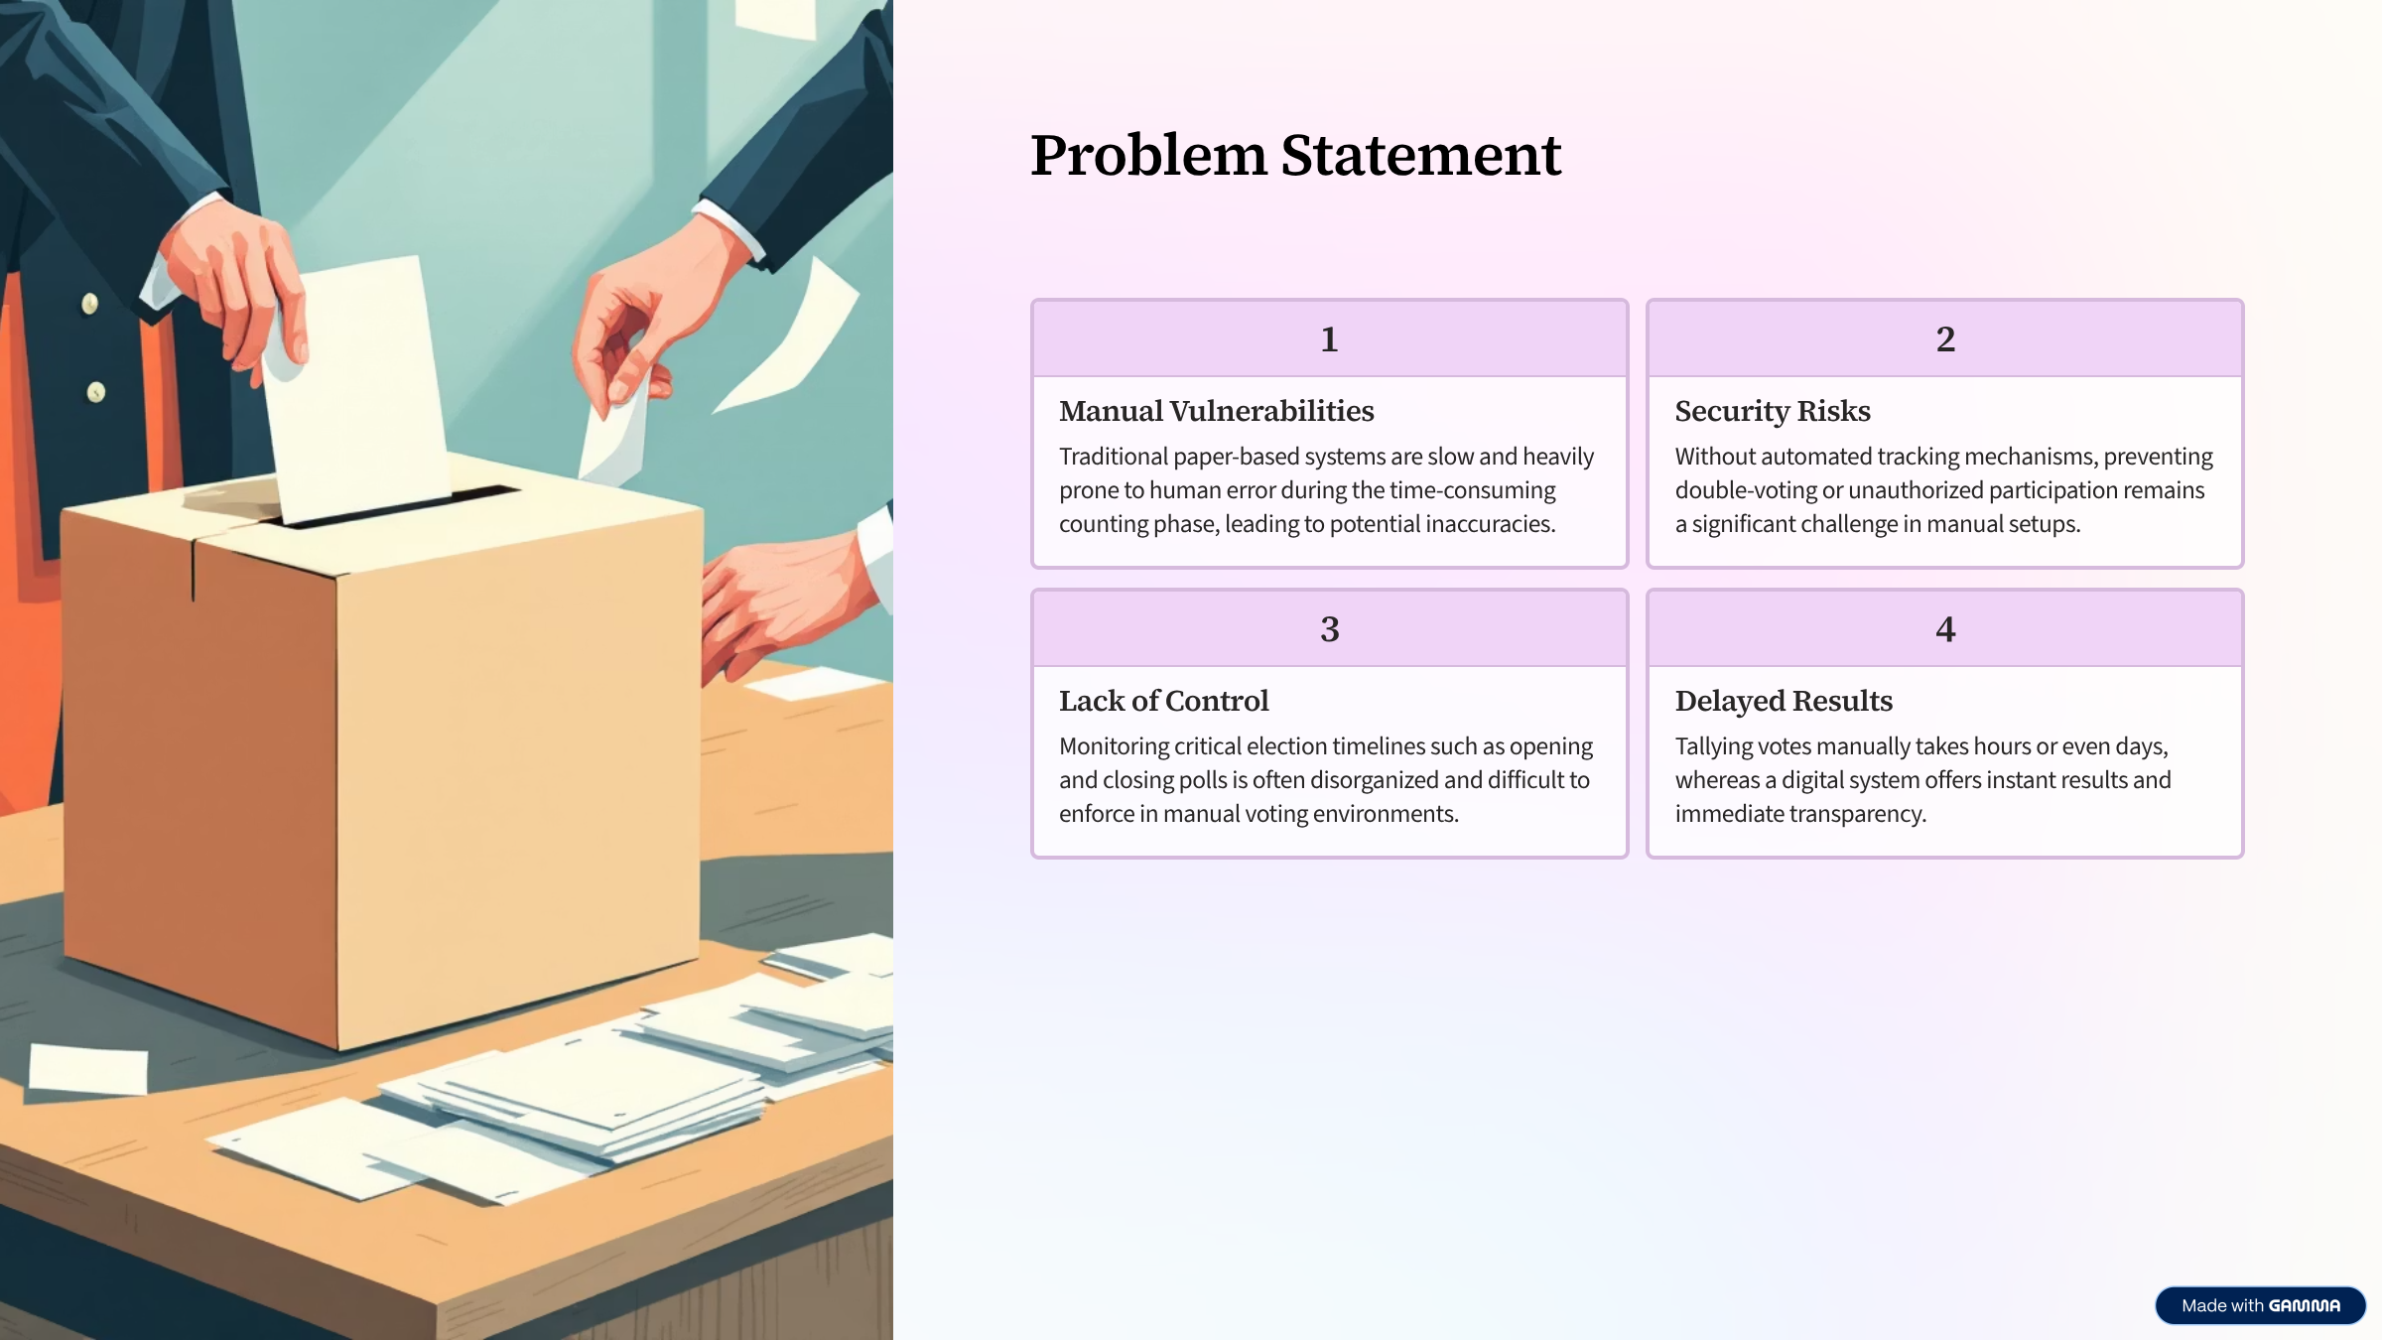


Slide 3
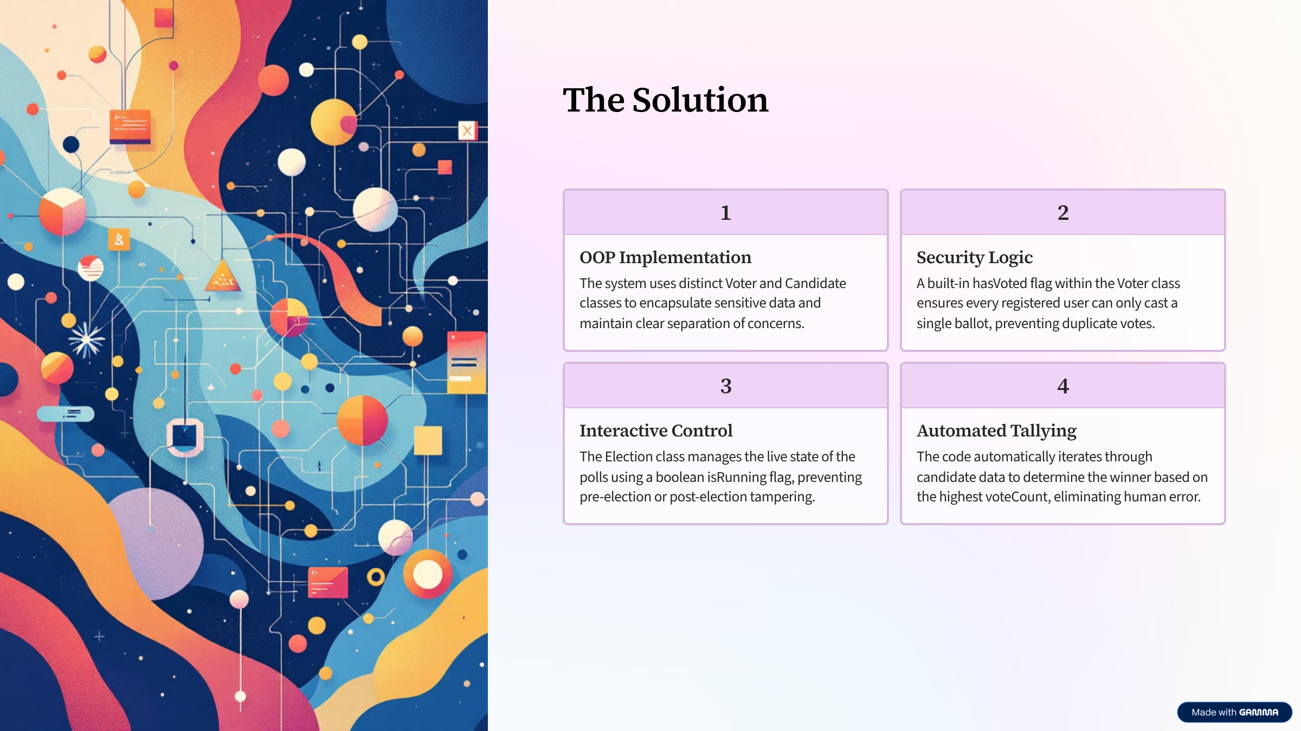

Slide 4
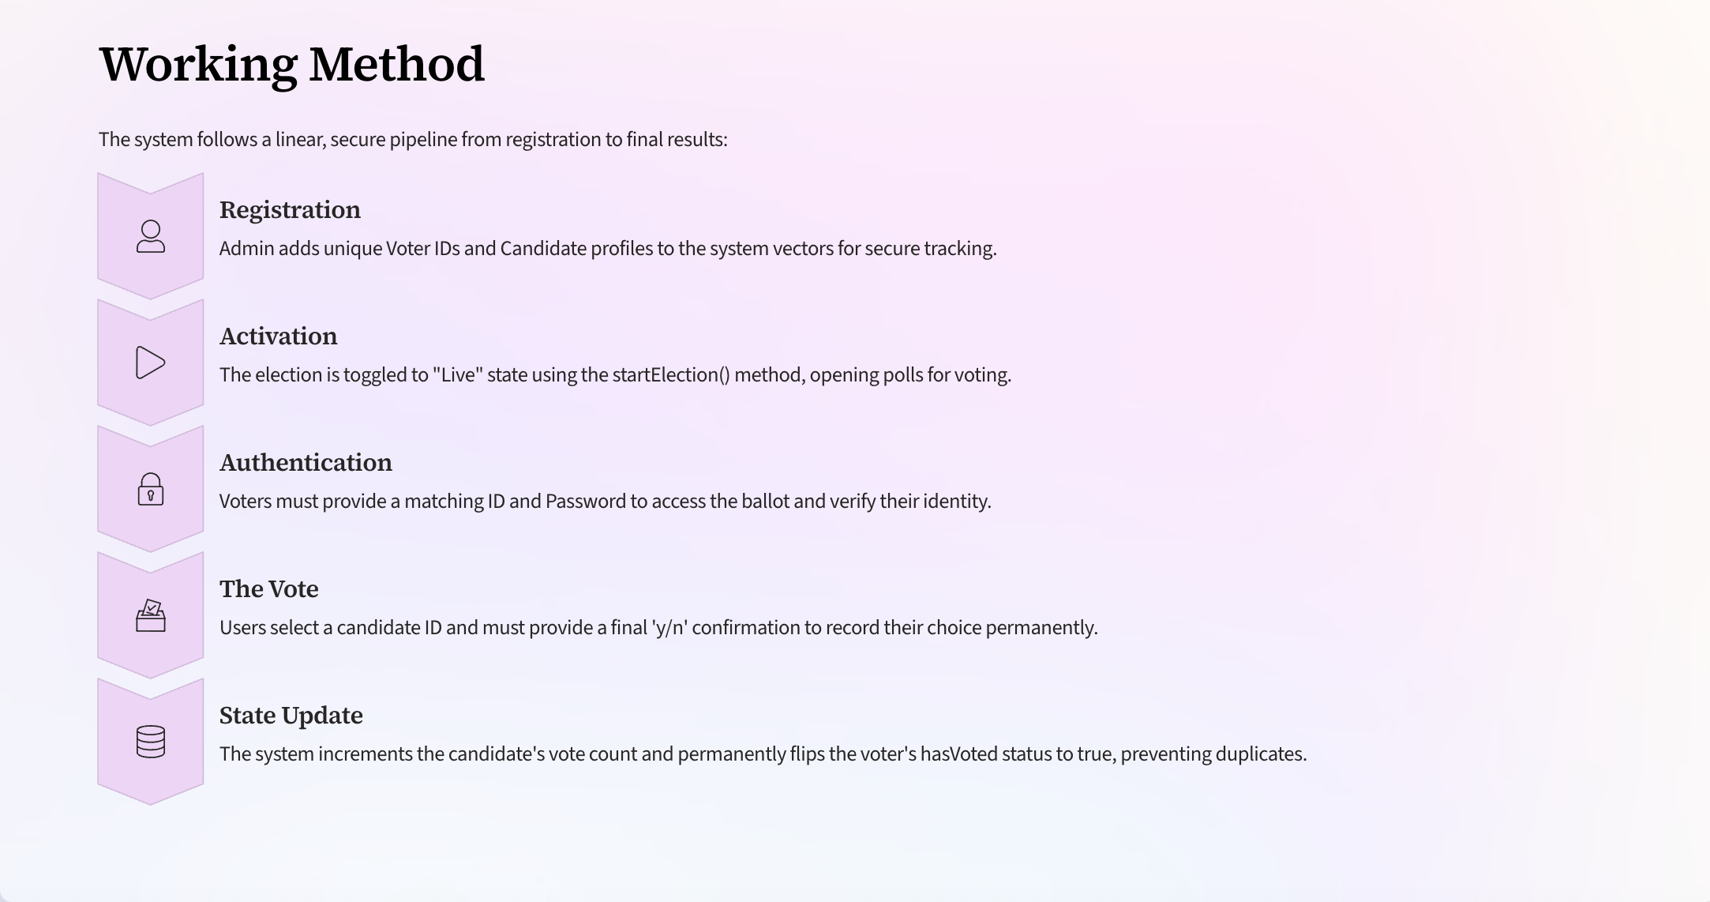

Slide 5
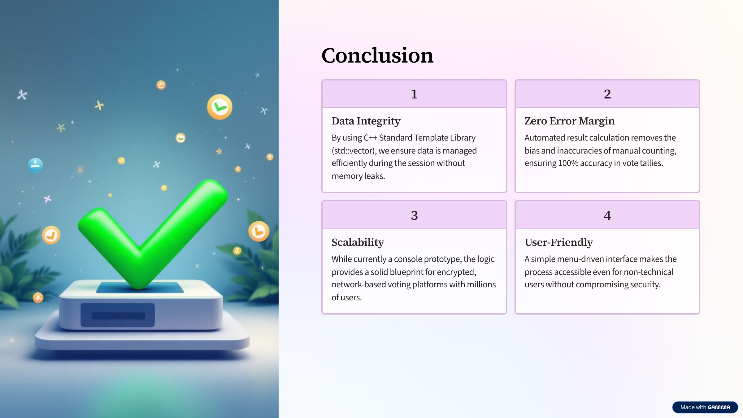

Slide 6
Thank You

